Slide 1
Seeing Is Believing: Successful Co-Teaching for English Learners
Andrea Honigsfeld, Ed.D. Maria G. Dove, Ed.D.
ahonigsfeld@molloy.edu mdove@molloy.edu
Molloy College,
Rockville Centre, NY

Slide 2
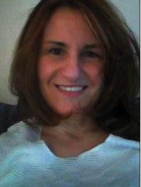
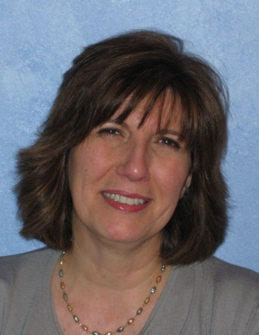
Our Collaborations
Andrea: co-taught in New York City
Maria: co-taught in Valley Stream, NY
Collaborate through Molloy College
Division of Education
Co-authored multiple articles, book chapters, and books
Co-present regularly at state and national conferences
Co-facilitate workshops for school districts and educational agencies throughout the United States
Notes:
2
Introduce yourself to the participants.

Slide 3
Selected Co-Authored Publications
Special thanks to Corwin Press

Slide 4
http://coteachingforells.weebly.com/

Slide 5
Agenda
Establish the rationale for collaborative instructional services
Explore the instructional cycle – co-planning, co-teaching, co-assessment, and reflection—through video analysis
Use the DELIVER tool to examine instructional practices in the co-taught class

Slide 6
Why?
Why would any school shift away from a pullout/stand alone classes for English learners?
What is the most compelling reason for systemic change?

Slide 8
Reflection for Building Partnerships
Developing a structure for formal reflection can enhance decision making and render judgments regarding practices that positively affect student learning (Honigsfeld & Dove, 2010).

Slide 10
POWER WORDS
RESPECT
ENGAGE
EQUALITY OF RELATIONSHIP
HONESTY
MATURITY
PROFESSIONALISM
ACKNOWLEDGE
PARAPHRASING
POSITIVITY
POSITIVE INTENTIONS
COMMITMENT
PERSERVERANCE
TRUST
GROW TOGETHER
AWARENESS
REFLECTION
SELF-REFLECTION

Slide 11
Integrated Collaborative Teaching Cycle
Co-Plan
Co-Instruction
Co-Assess
Reflect
Notes:
----- Meeting Notes (5/12/15 13:09) -----
Consider the instructional cycle and determine how to make it happen in your school. What kind of support can we offer you or can your colleagues offer you to implement this instructional cycle?
----- Meeting Notes (7/28/15 11:35) -----
Four Corner Activity: Break participants into four groups and assign each group to one of the four corners -
----- Meeting Notes (7/28/15 13:25) -----
Each corner is one element from the collaborative instructional cycle: Co-planning, co-teaching, co-assessing, and reflection.

Slide 12
Video Viewing
NOTICINGS | WONDERINGS

Slide 13
Co-Planning

Slide 14
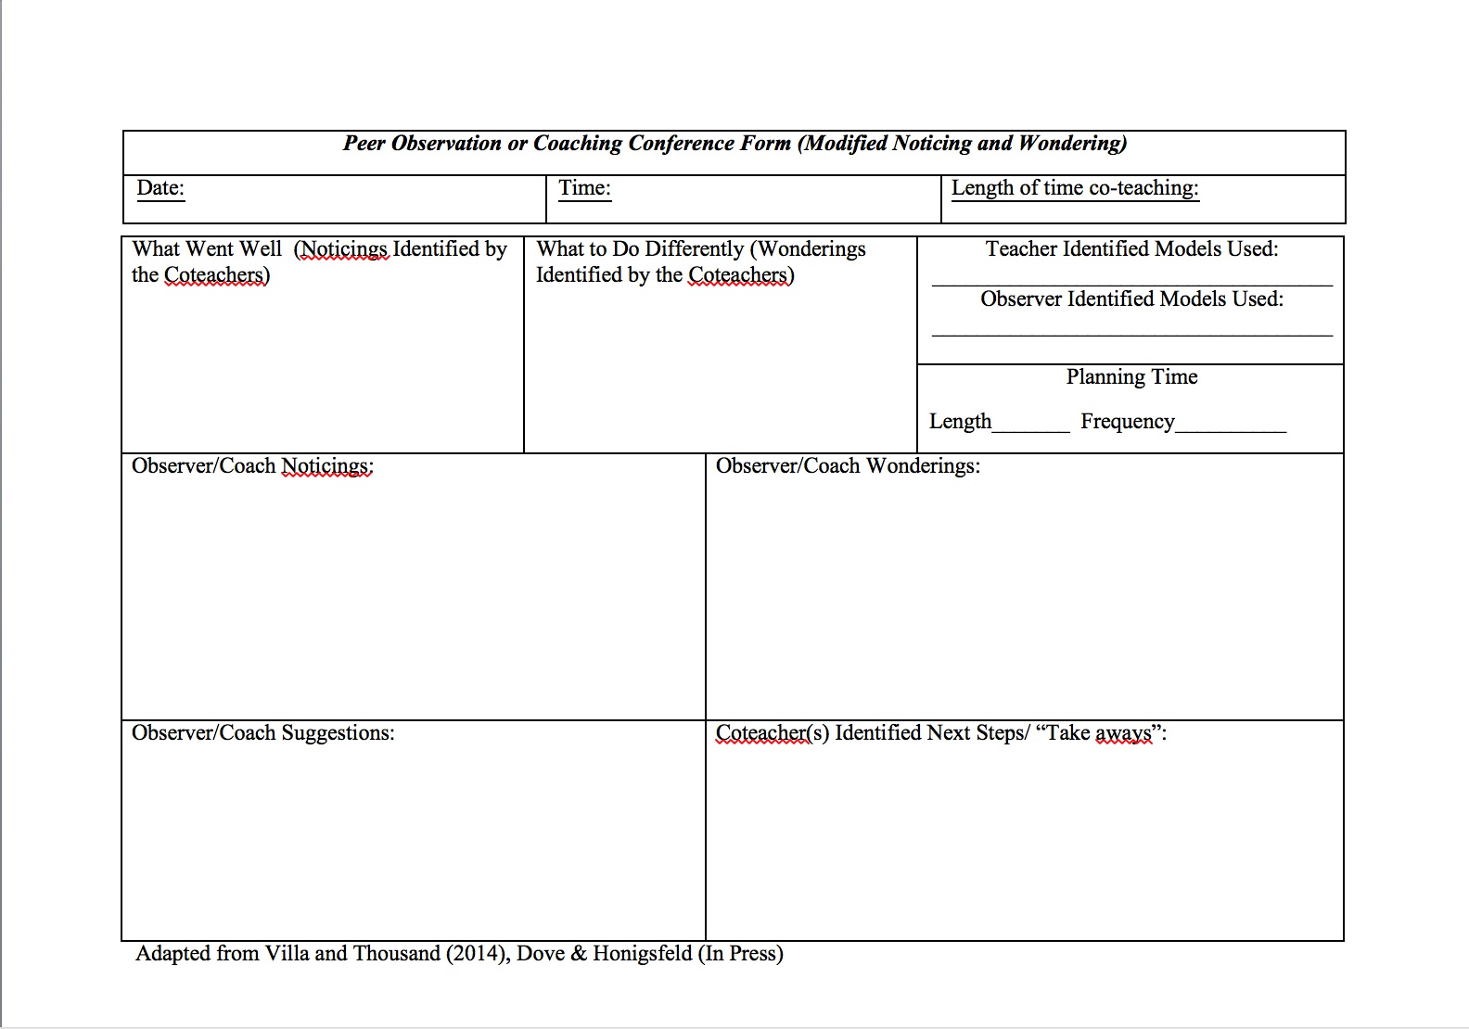

Slide 16
DELIVER
Differentiation
Engagement
Language Objectives
Instructional Strategies
Rigor
Varied Teaching Practices
Equity
Notes:
Distribute modified DELIVER TOOL

Slide 17
DELIVER
Differentiated instruction
Engagement of students (SWRL)
Language and content objectives
Instructional strategies for ELLs
Varied co-teaching models
Equity established for students & teachers
Rigor in content, process, and/or product

Slide 18
Differentiated Instruction
Differentiate instruction, first popularized by Dr. Carol Ann Tomlinson, can be addressed as follows:
CONTENT
PROCESS
PRODUCT
LEARNING ENVIRONMENT

Slide 19
Levels of Curriculum Planning
District
School
Content
Grade-Level
Class or group
Individual Level

Slide 20
Student Engagement: SWRL
For language learning, create a SWRLing classroom for English learners with opportunities for students to SPEAK, WRITE, READ, and LISTEN everyday.

Slide 21
Language & Content Objectives
“Connect language and content to make learning meaningful and relevant for ELLs”

Slide 22
Instructional Strategies for ELLs
Visuals
Realia
Cognates
Pacing
Step-by step demonstration/modeling
Guided practice
Scaffolding
Use of home language
Other_______________

Slide 23
Varied Co-Teaching Models

Slide 24
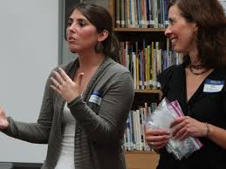
Equity for Co-Teachers

Slide 25
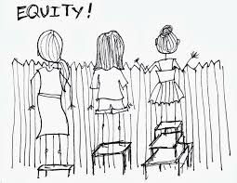
Equity For Students
Notes:
Access to general education curriculum
Supportive class and school environment
Use of home language
Bias in textbooks and materials
Student discipline

Slide 26
Change the Story

Slide 27
RIGOR
CONTENT
PROCESS
PRODUCT

Slide 28
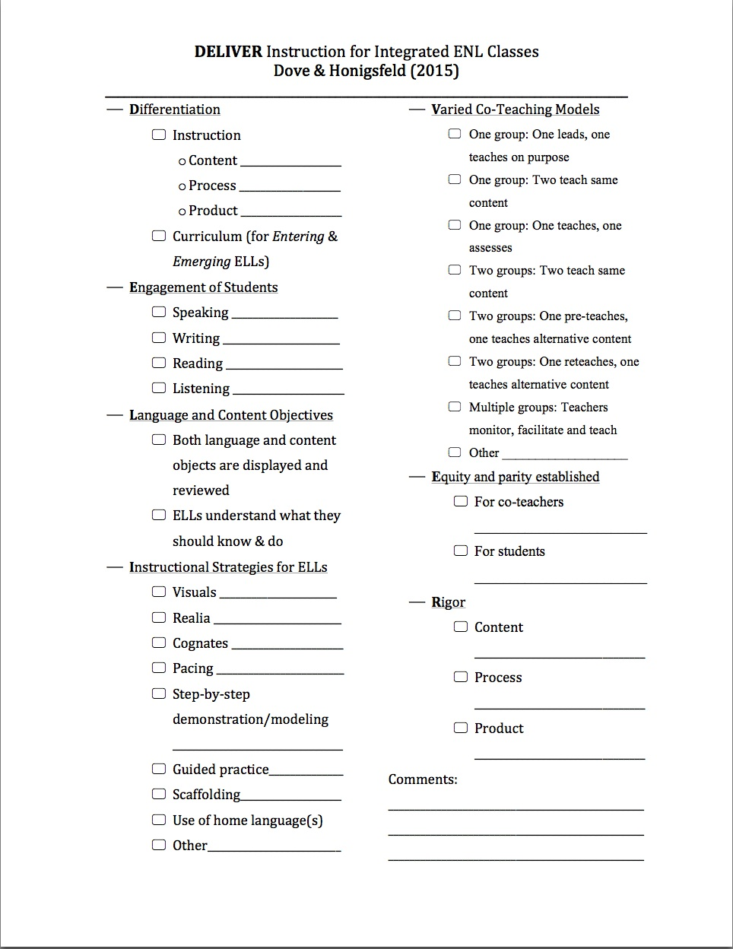

Slide 29
Video Case Studies

Slide 30
VIDEO VIEWING
Using the DELIVER Tool

